Slide 1
Pygame prototype

Slide 2
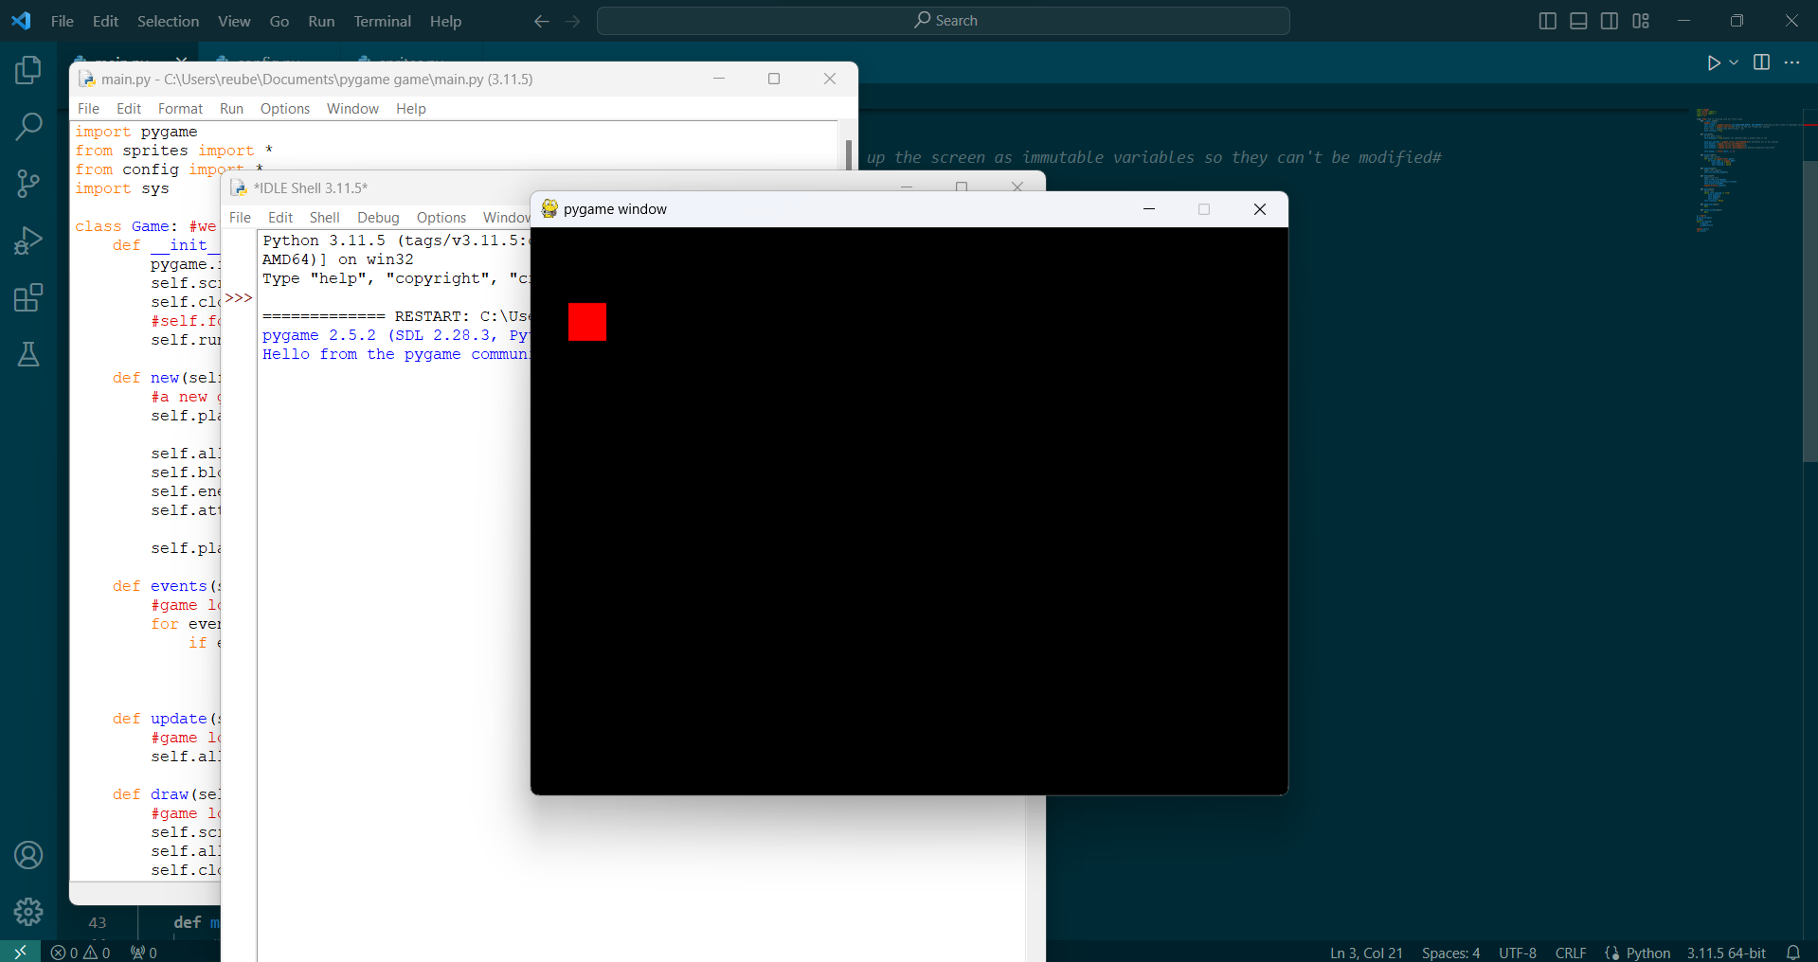
I first developed code to display a red rectangle in a black background in PyGame.

